Slide 1


Dr. Runxuan Zhang
Dr. Wenbin Guo
12 December 2018

Slide 2

What is 3D RNA-seq App?
An program for differential gene expression and alternative splicing analysis of RNA-seq data designed for speed, accuracy and ease of use
Comparative expression analysis based on RNA-seq (3D):
Differential expression (DE)
Differential alternative splicing (DAS)
Differential transcript usage (DTU)
The whole analysis only takes 3 Days (3D):
Transcript quantification using Salmon, Kallisto, etc. (1-2 Days)
“Mouse click” 3D analysis using 3D RNA-seq App (< 1 Day)
3D RNA-seq allows:
Accurate and rapid analysis of RNA-seq data
Analysis of differential expression/alternative splicing at the gene and transcript level
Easy to use graphical interface which can be used by non-bioinformaticians
Report with data visualisation (heat-maps, GO analysis, etc.)

Slide 3
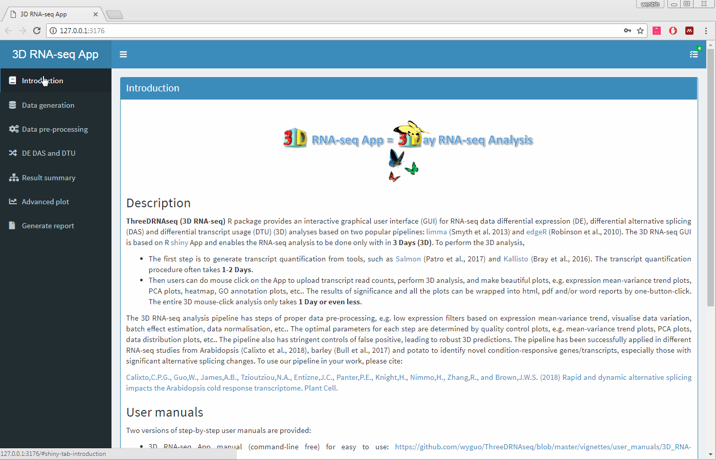
What is 3D RNA-seq App?

Slide 4
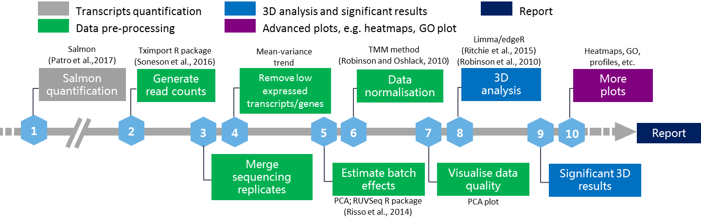
What does 3D RNA-seq App do?
Data generation
Transcript quantification from salmon/kallisto
Tximport R package (Soneson et al. 2016)
Tximport has 3 options:
no: raw read counts from quantification, no correction.
scaledTPM: scaled up to library size (sequencing depth).
lengthScaledTPM: scaled using the average transcript length over samples and then the library size (recommended by Soneson et al. 2016).

Slide 5
What does 3D RNA-seq App do?
Data pre-processing
Merge sequencing replicates
Same biological replicate is sequenced several times
Not real technical replicates and do not provided much information to the technical variation.
Add them to increase sequencing depth.

Slide 6
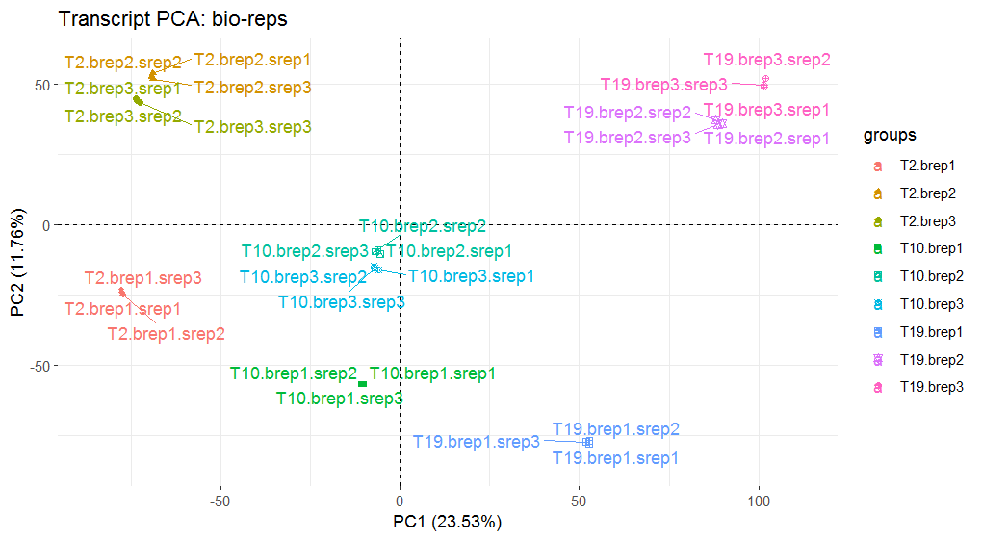
What does 3D RNA-seq App do?
Brep: biological replicates; Srep: sequencing replicates
3 time-points, 3 breps, 3 sreps

Slide 7
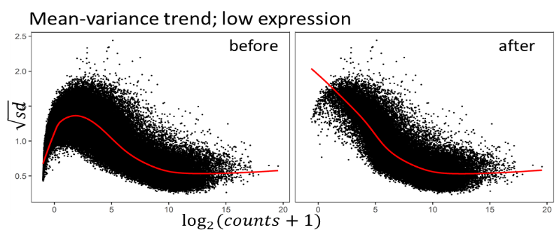
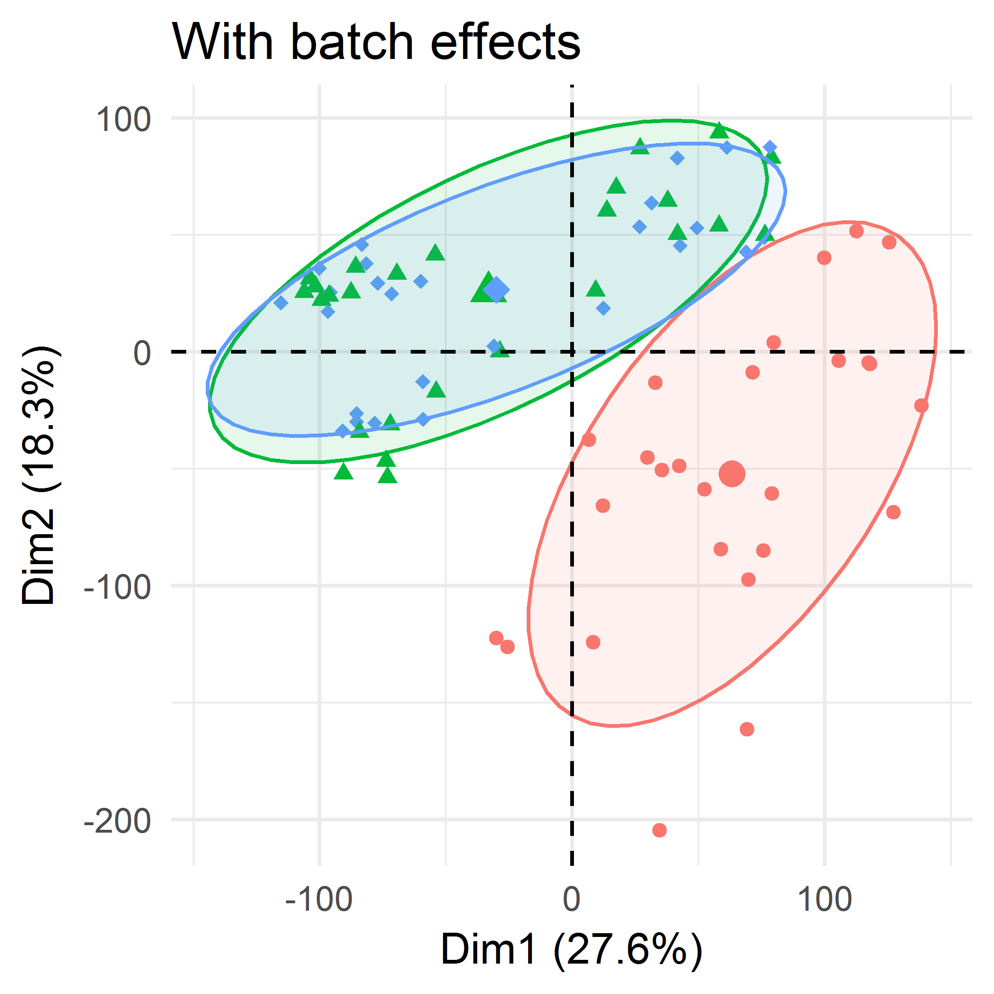
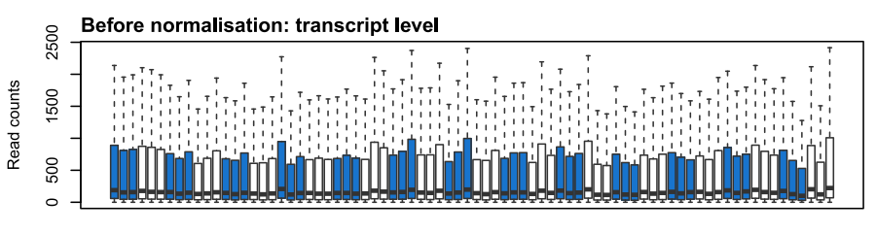
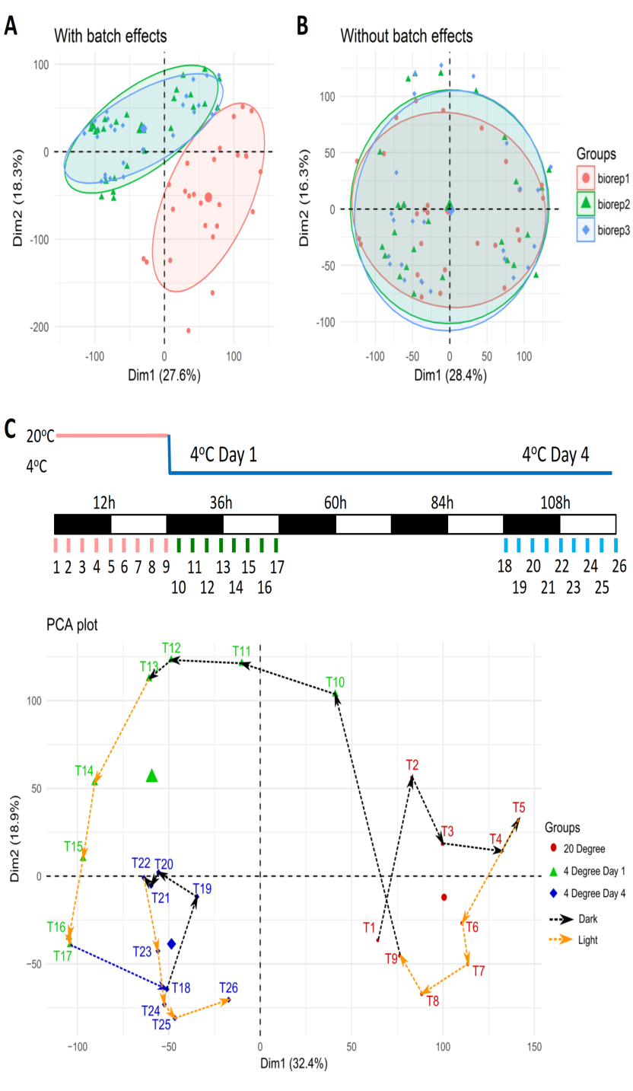
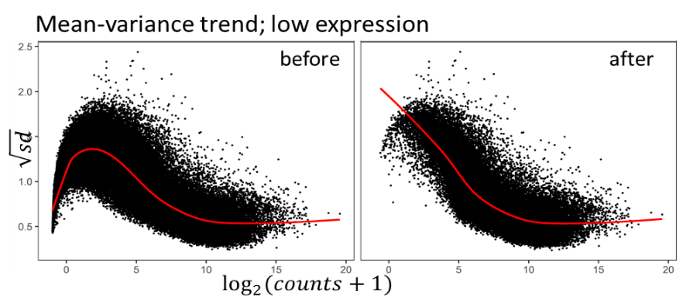

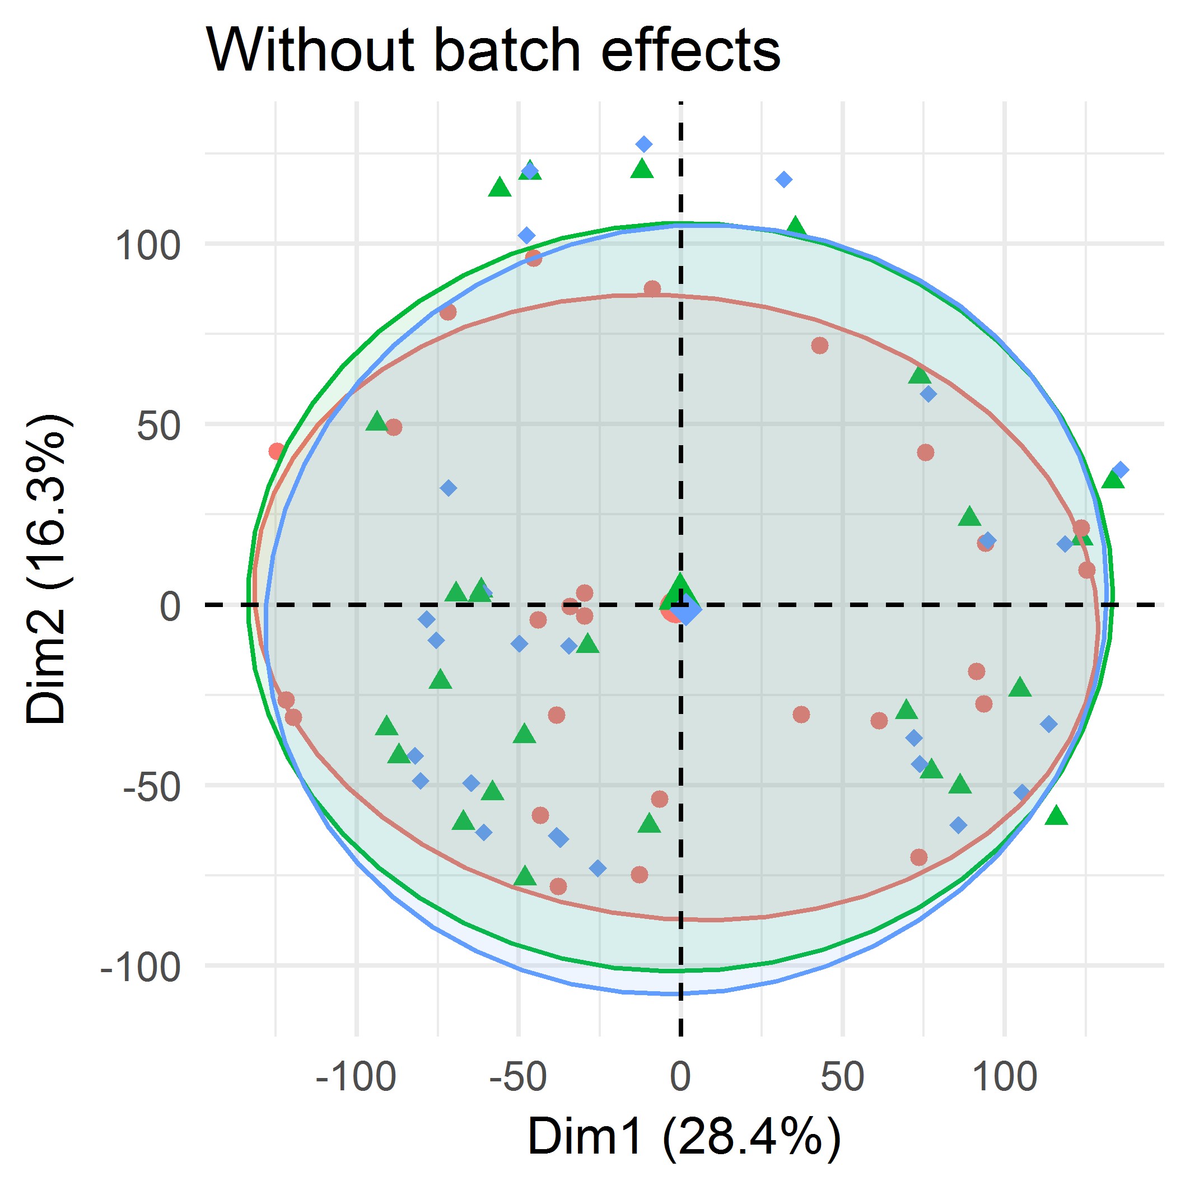
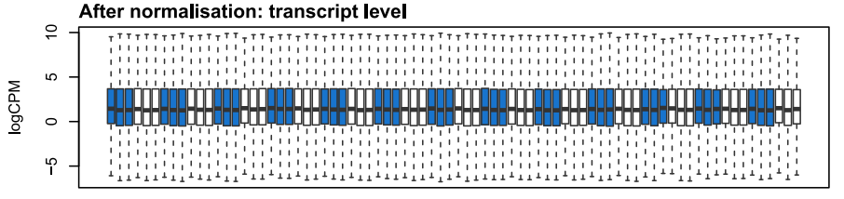
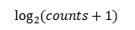
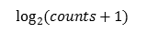
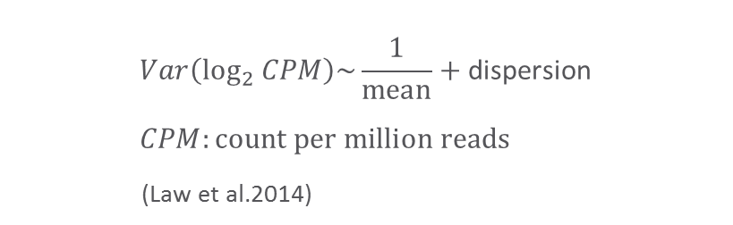
What does 3D RNA-seq App do?
Data pre-processing
Figures for data quality controls
4
5
6
7
low
Brep2&3
2012
$$Var\left(\log_{2}{CPM}\right)\sim \frac{1}{mean}+\text{dispersion} \\ CPM:count per million reads$$
(Law et al.2014)
Batch effect
Brep1
2010
$$\log_{2}{(counts+1)}$$
samples
removed
$$\log_{2}{(counts+1)}$$
PCA; Data quality
Mean-variance; remove low expression
PCA; Batch effects
Normalisation
Figures were from 26 time-points RNA-seq study of Arabidopsis in response to cold (Calixto et al., 2018)

Slide 8
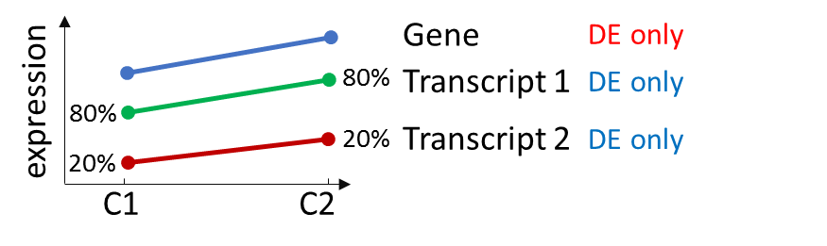
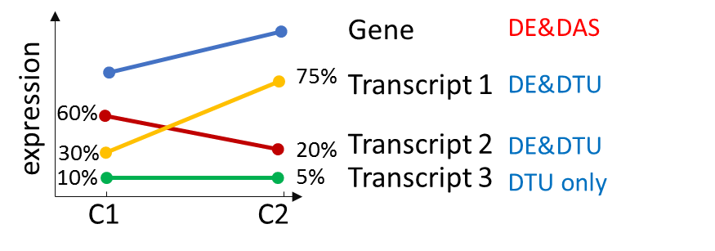
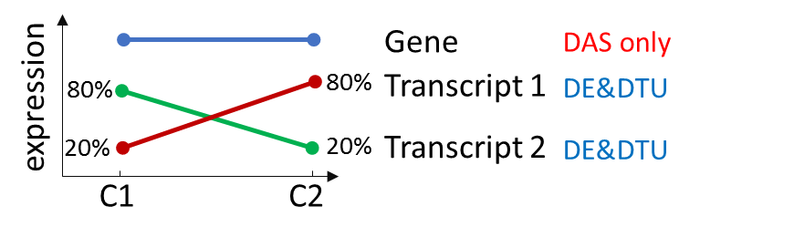
What does 3D RNA-seq App do?
3D analysis and summary significant results
DE: abundance change between conditions
DAS gene: changes of this gene are different to its transcripts
DTU transcript: changes of this transcript are different to all the other transcripts

Slide 9
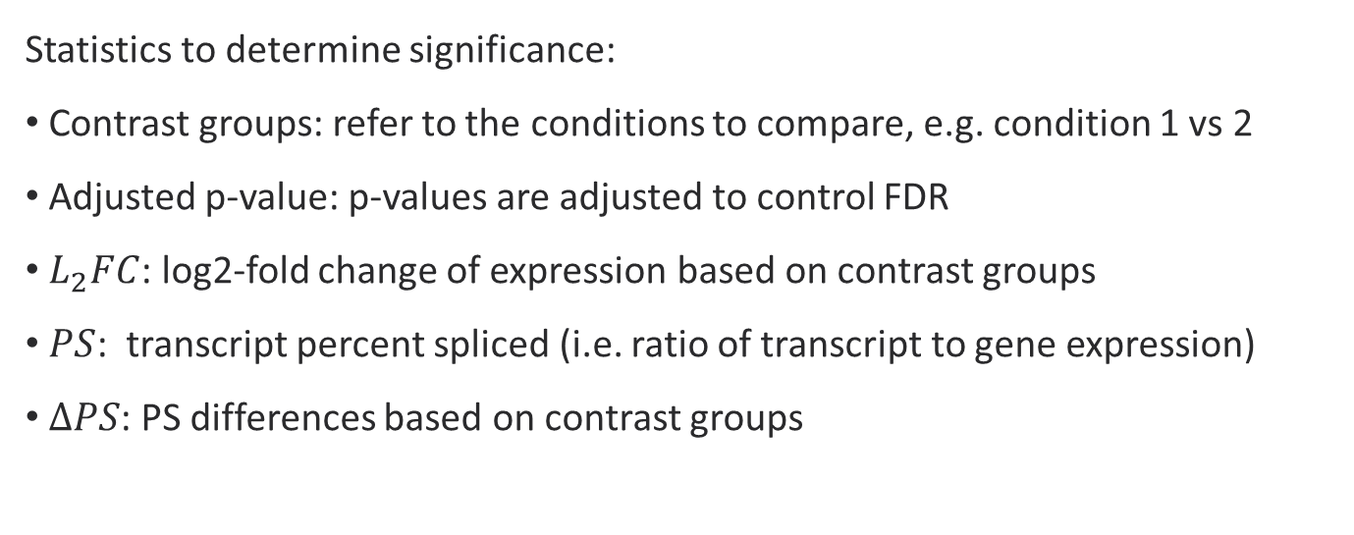
What does 3D RNA-seq App do?
3D analysis and summary significant results
Statistics to determine significance:
Contrast groups: refer to the conditions to compare, e.g. condition 1 vs 2
Adjusted p-value: p-values are adjusted to control FDR
$L_{2}FC$: log2-fold change of expression based on contrast groups
$PS$: transcript percent spliced (i.e. ratio of transcript to gene expression)
$ΔPS$: PS differences based on contrast groups

Slide 10
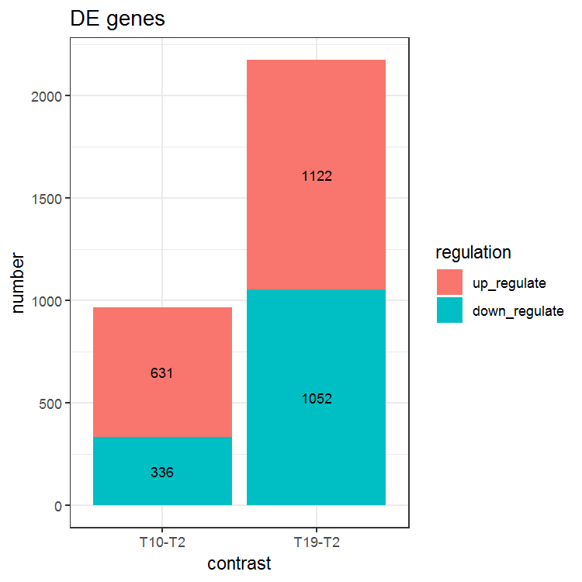
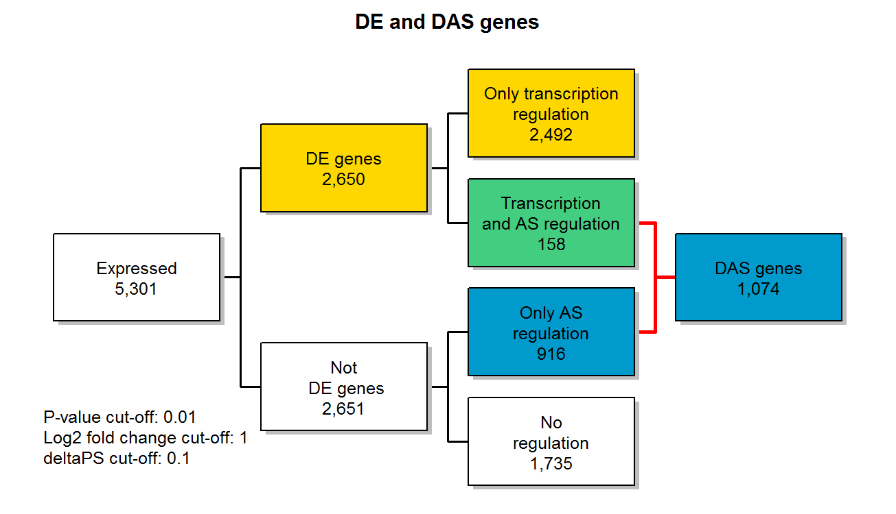
What does 3D RNA-seq App do?
3D analysis and summary significant results
DE only
DE&DAS
DAS only

Slide 11
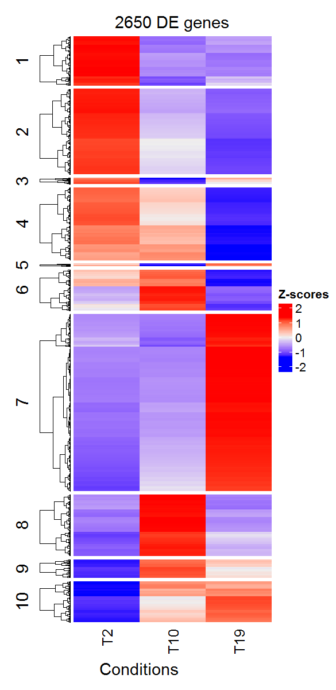
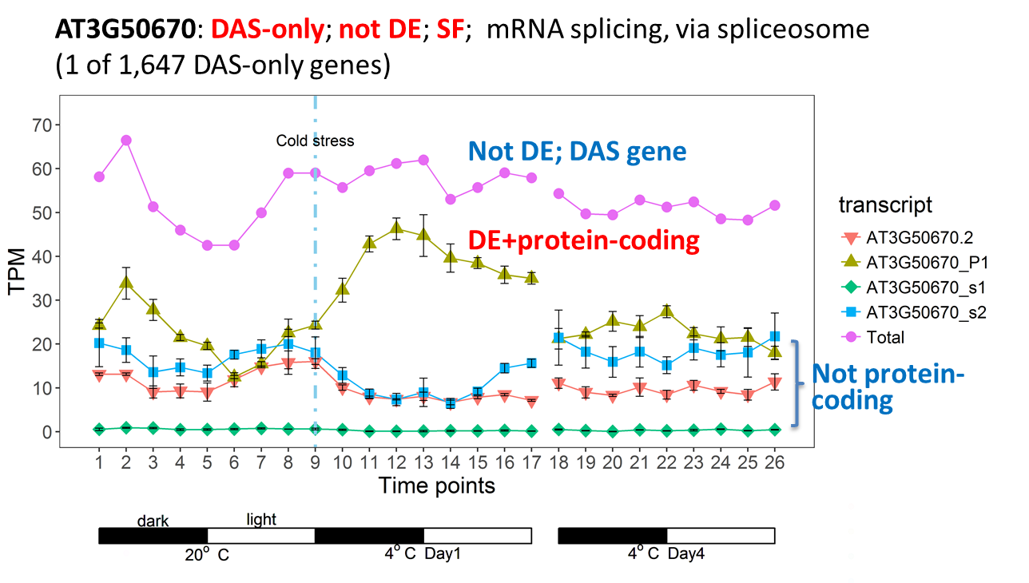
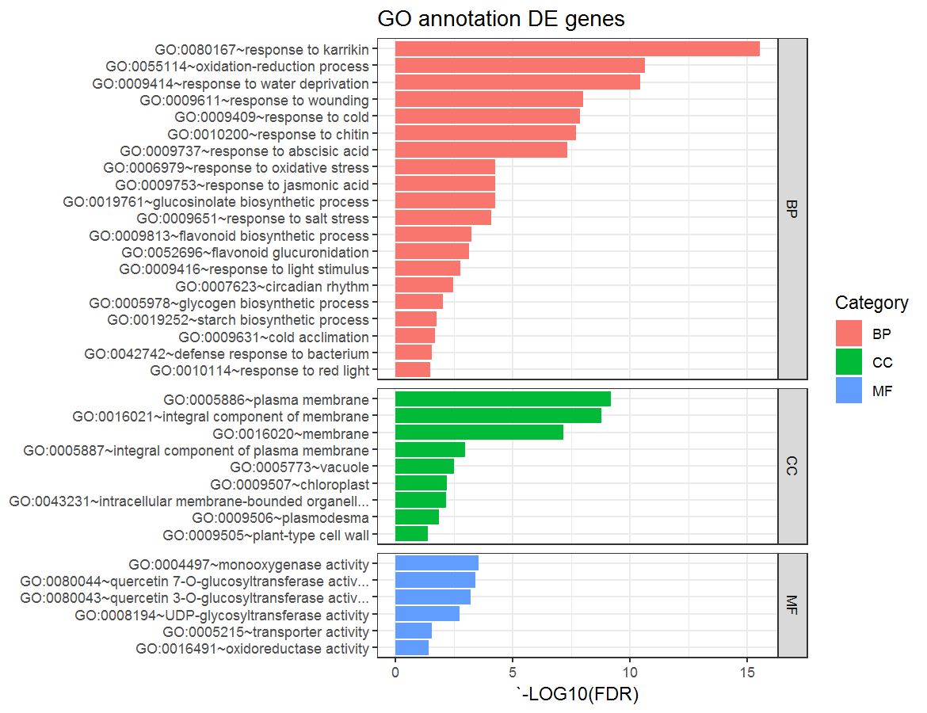
What does 3D RNA-seq App do?
Result visualisation
heatmap
Profile plot
(Calixto et al., 2018)
GO annotation plot

Slide 12
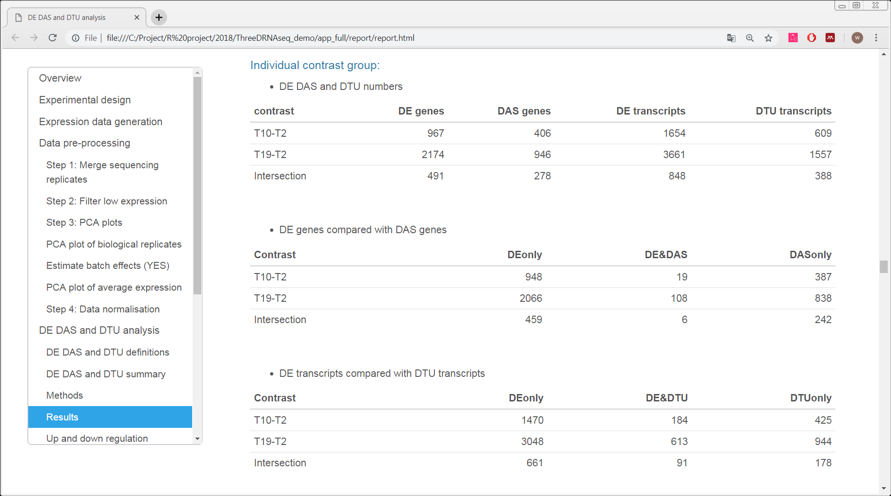
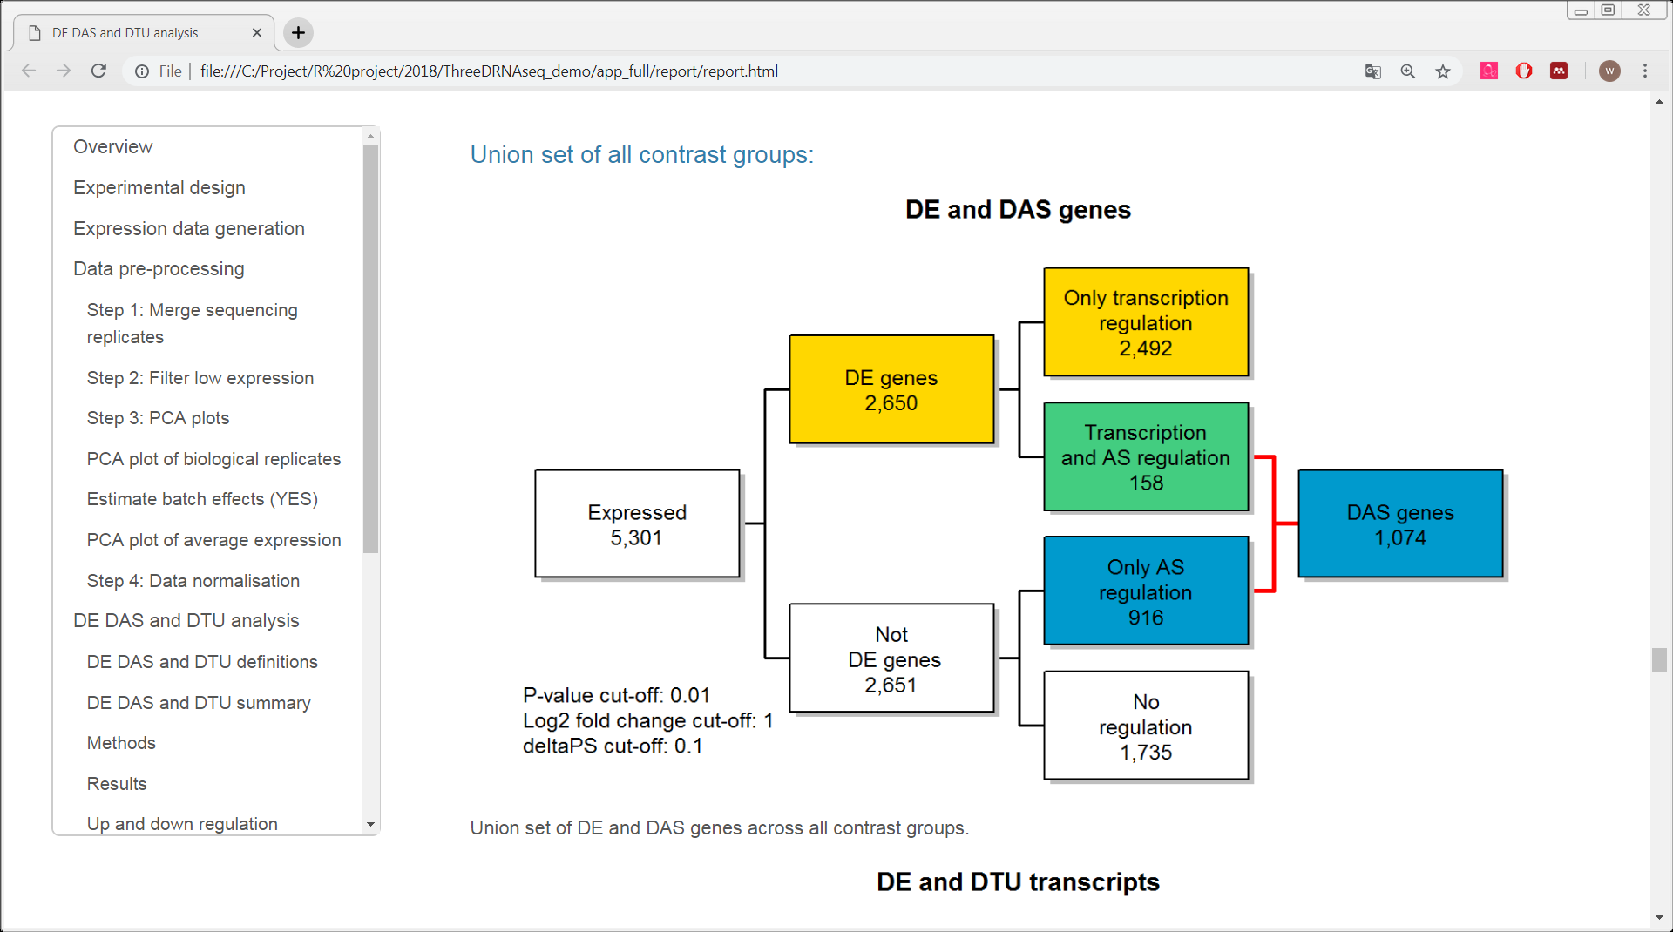
What does 3D RNA-seq App do?
Result visualisation
All the results and figures are saved in a report

Slide 13
A live demo of ThreeDRNAseq App

Slide 14
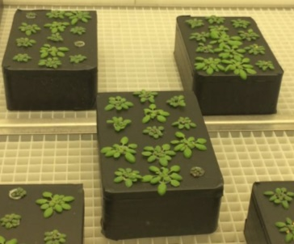
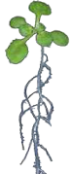

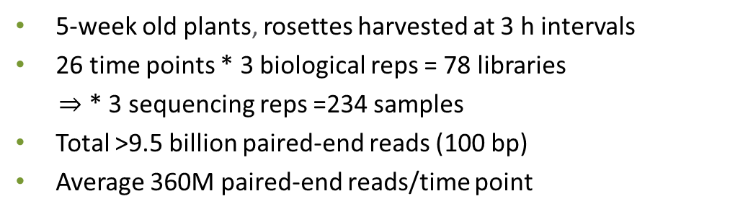
Example data: time-series of Arabidopsis in response to cold
RNA extraction
…
RNA-seq data analysis
Library
Bio-rep, Harvested
10-13 rosettes
Seq1
Seq2
Seq3
5-week old plants
Sequencing replicates
“Transition”
“Acclimation”
Contrast groups: T19 vs T2, T10 vs T2
5-week old plants, rosettes harvested at 3 h intervals
26 time points * 3 biological reps = 78 libraries
$⇒$ * 3 sequencing reps =234 samples
Total >9.5 billion paired-end reads (100 bp)
Average 360M paired-end reads/time point
For more details:
Calixto et al, 2018, Plant Cell
James et al,. 2018, Plant, Cell&Environment.

Slide 15
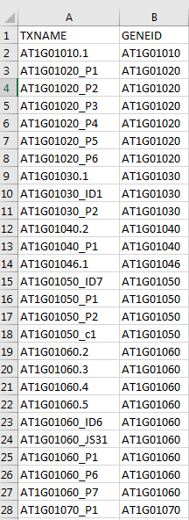
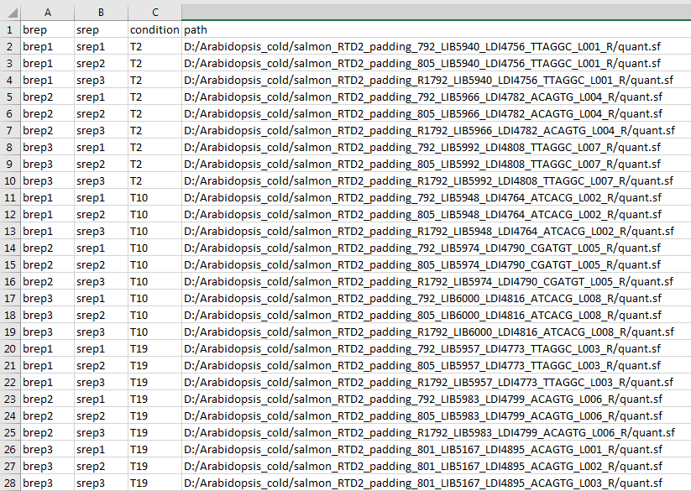
Input data
Transcript-gene mapping csv
Sample information csv
Transcripts
Gene
Transcript quantification paths
Labels of biological replicates
Labels of sequencing replicates
Labels of conditions

Slide 16

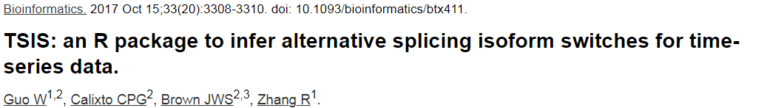
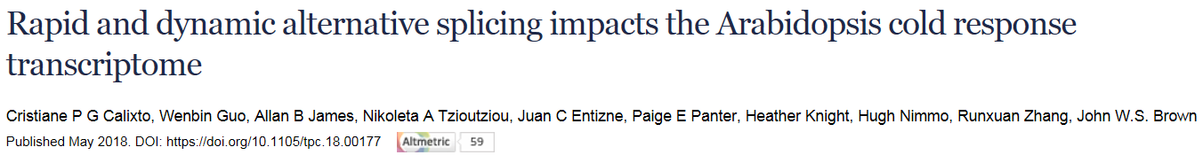
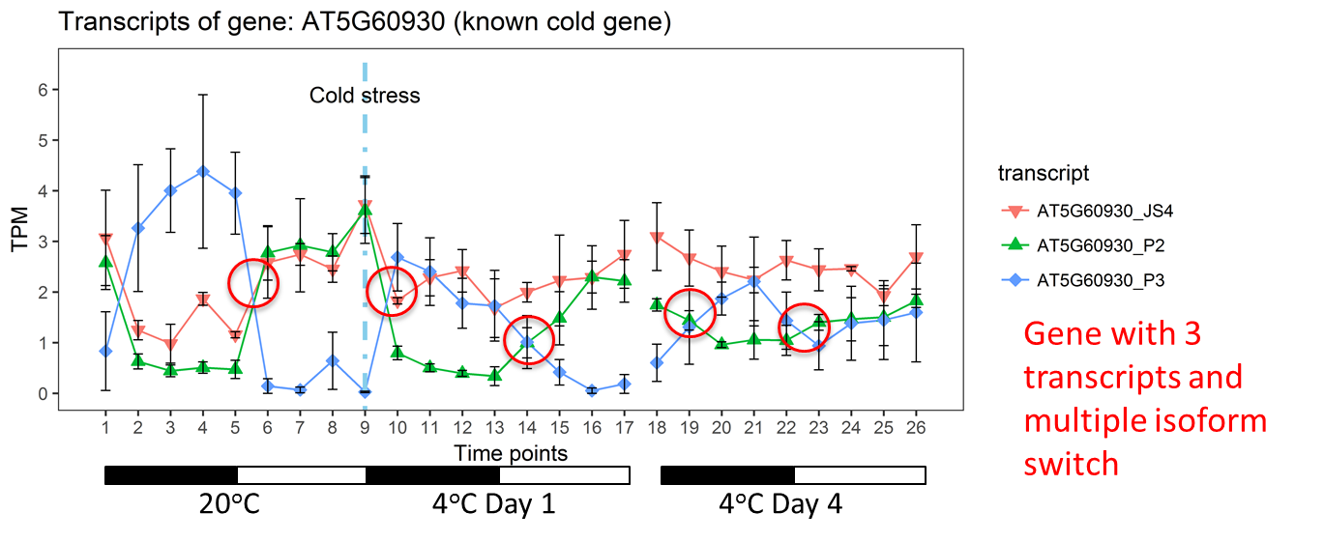
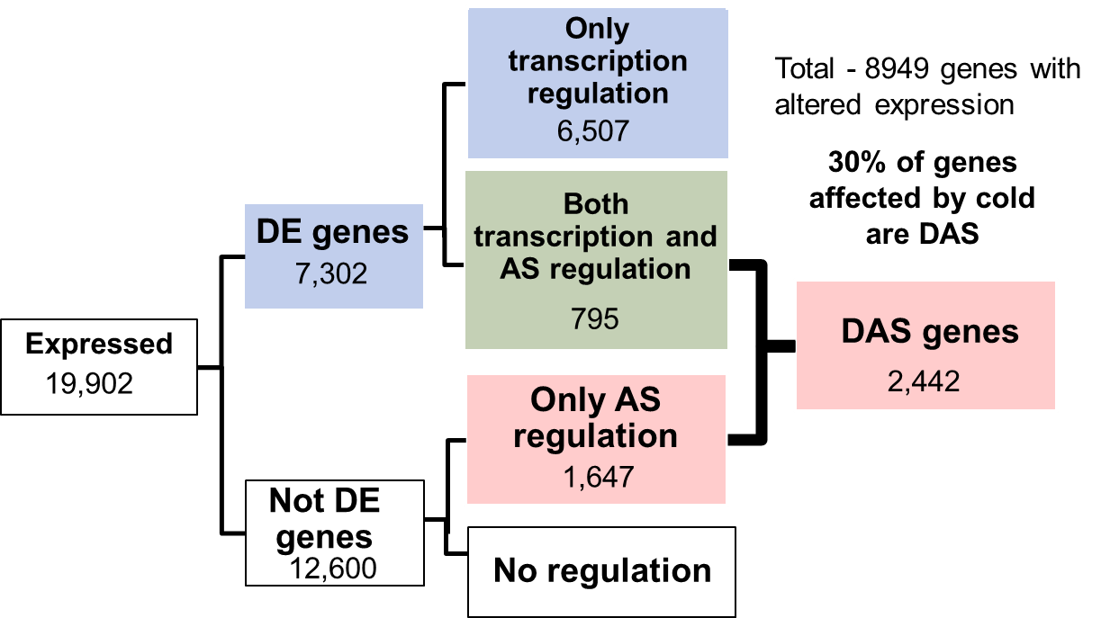
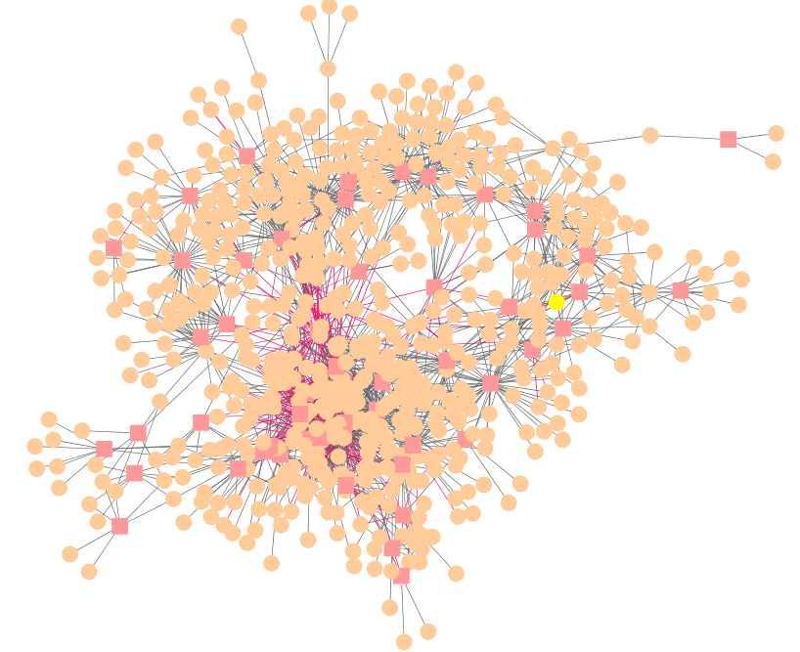
How to use 3D genes/transcripts?
3D analysis application in Arabidopsis
Time-series isoform switch of DAS genes/DTU transcripts
Guo et al., 2017
Calixto et al., 2018
Transcriptional and AS regulatory networks
Novel cold-response genes
DAS genes – regulated only by AS
Dynamics of AS/transcription
Value of RTD to expression analysis
Keep eye on our publications

Slide 17
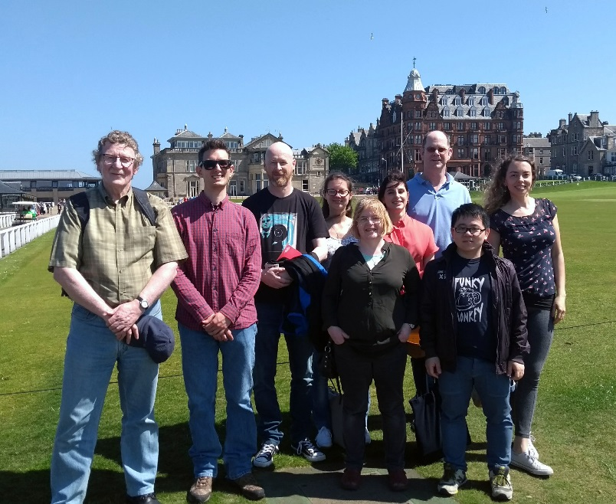



Acknowledgements
Runxuan Zhang
Wenbin Guo
John Brown
Cristiane Calixto Nikoleta Tzioutziou
Juan Carlos Entizne
Scottish
Government
Runxuan.Zhang@hutton.ac.uk
Wenbin.Guo@hutton.ac.uk

Slide 18
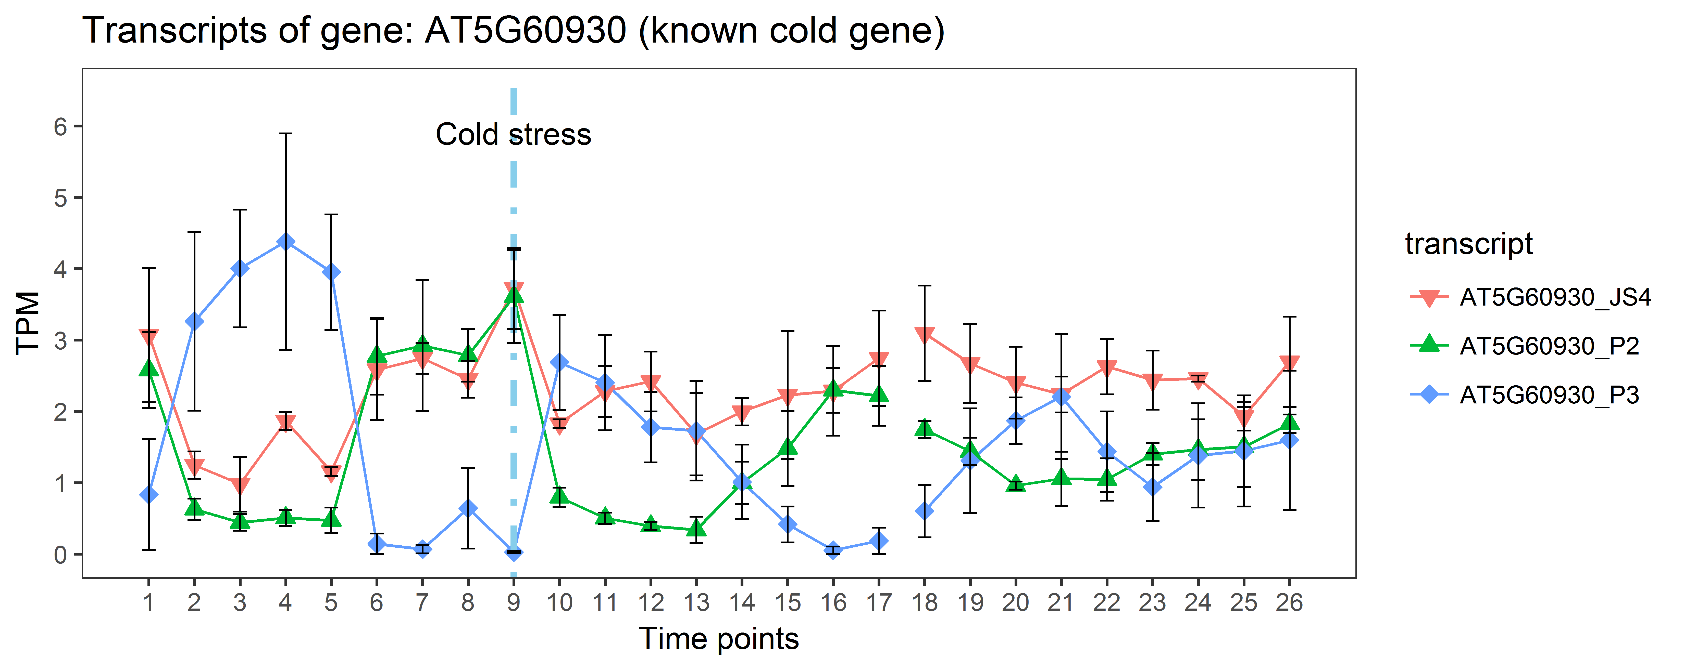
TSIS: time-series isoform switch
--transcript isoforms from the same gene reverse relative abundance between conditions
Guo et al., 2017
Gene with 3 transcripts and multiple isoform switch
20ºC
4ºC Day 1
4ºC Day 4
AT5G60930: P-loop containing nucleoside triphosphate hydrolases superfamily protein
Figures were from RNA-seq study of Arabidopsis in response to cold (Calixto et al., 2018)

Slide 19

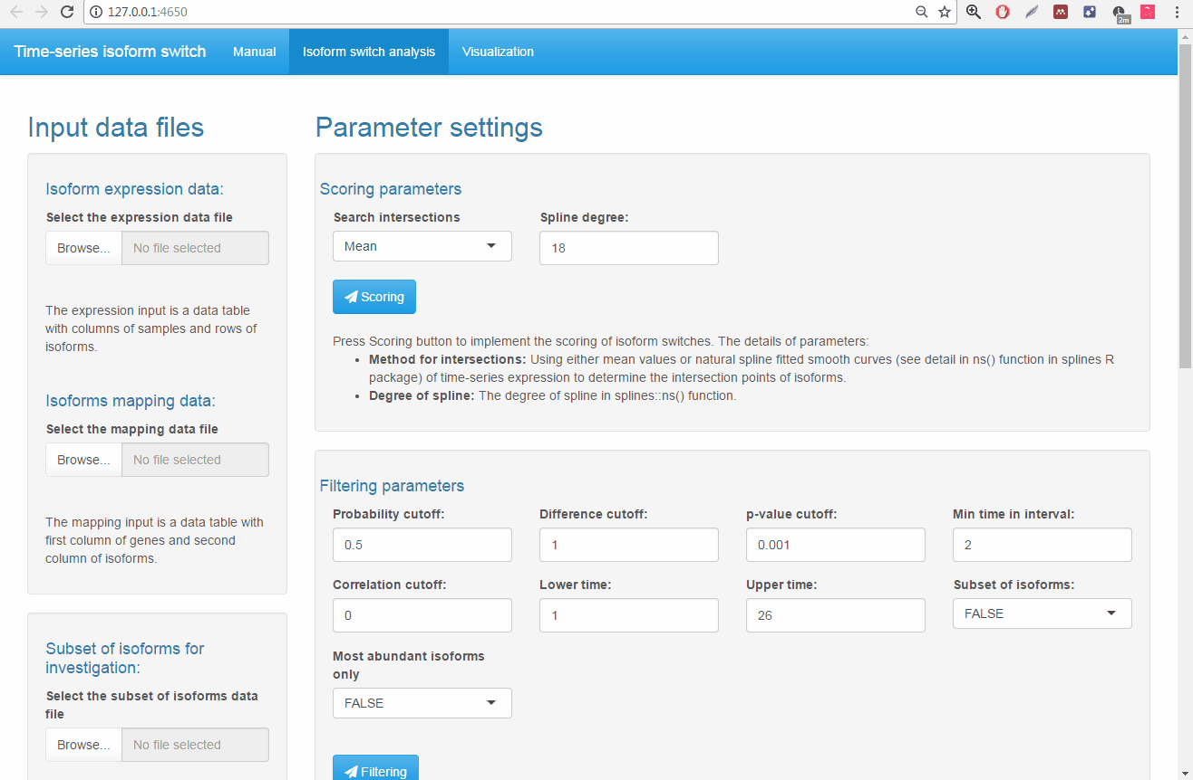
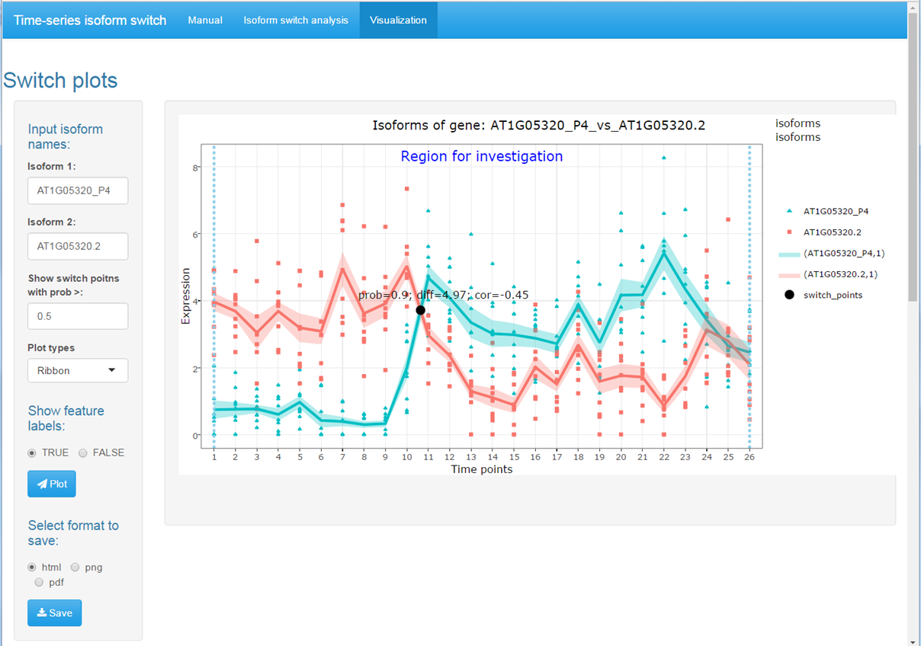
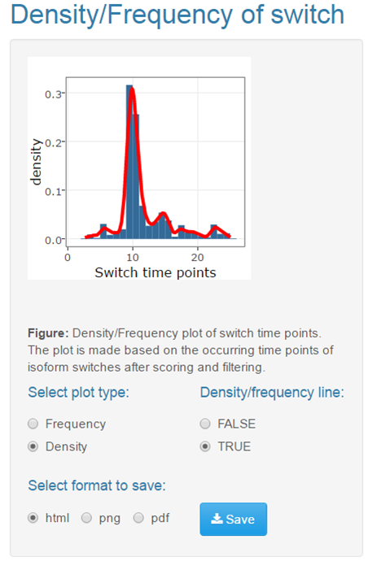
TSIS: time-series isoform switch
TSIS package (Guo, Calixto, Brown, et al., 2017)
install use code devtools::install_github(‘wyguo/TSIS’)
TSIS GUI (graphical user interface) based on Shiny Web App in RStudio
Github page: https://github.com/wyguo/TSIS

Slide 20
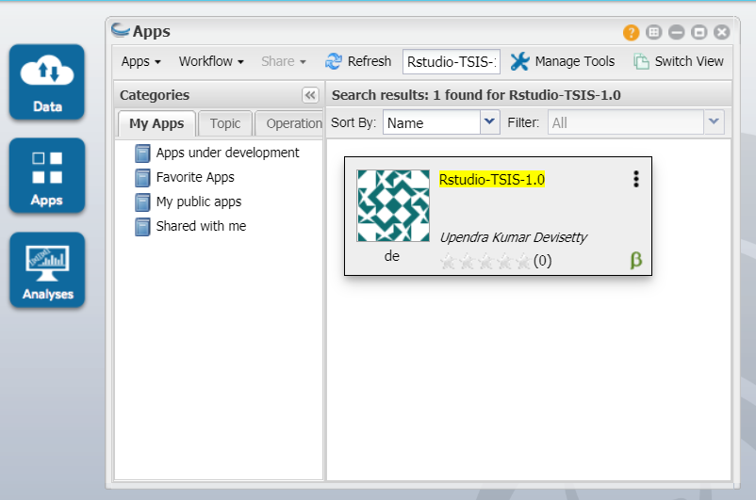
TSIS: time-series isoform switch
Search App: Rstudio-TSIS-1.0
Tutorial is available soon:
https://github.com/wyguo/TSIS/blob/master/TSIS_on_Cyverse.md

Slide 21
Reference
Kallisto: Bray,N.L., Pimentel,H., Melsted,P., and Pachter,L. (2016) Near-optimal probabilistic RNA-seq quantification. Nat. Biotechnol., 34, 525–527.
Normalisation: Bullard,J.H., Purdom,E., Hansen,K.D., and Dudoit,S. (2010) Evaluation of statistical methods for normalization and differential expression in mRNA-Seq experiments. BMC Bioinformatics, 11, 94.
3DRNAseq Application: Calixto,C.P.G., Guo,W., James,A.B., Tzioutziou,N.A., Entizne,J.C., Panter,P.E., Knight,H., Nimmo,H.G., Zhang,R., and Brown,J.W.S. (2018) Rapid and dynamic alternative splicing impacts the Arabidopsis cold response transcriptome. bioRxiv, 251876.
Limma-voom: Law,C.W., Chen,Y., Shi,W., and Smyth,G.K. (2014) voom: Precision weights unlock linear model analysis tools for RNA-seq read counts. Genome Biol, 15, R29.
Salmon: Patro,R., Duggal,G., Love,M.I., Irizarry,R.A., and Kingsford,C. (2017) Salmon provides fast and bias-aware quantification of transcript expression. Nat. Methods, 14, 417–419.
RUVSeq: Risso,D., Ngai,J., Speed,T.P., and Dudoit,S. (2014) Normalization of RNA-seq data using factor analysis of control genes or samples. Nat. Biotechnol., 32, 896–902.
Limma: Ritchie,M.E., Phipson,B., Wu,D., Hu,Y., Law,C.W., Shi,W., and Smyth,G.K. (2015) limma powers differential expression analyses for RNA-sequencing and microarray studies. Nucleic Acids Res, 43, e47.
edgeR: Robinson,M., Mccarthy,D., Chen,Y., and Smyth,G.K. (2011) edgeR : differential expression analysis of digital gene expression data User ’ s Guide. Most, 23, 1–77.
Tximport: Soneson,C., Love,M.I., and Robinson,M.D. (2016) Differential analyses for RNA-seq: transcript-level estimates improve gene-level inferences. F1000Research, 4, 1521.

